Slide 1
Boosting algorithms
By
S. Monisha

Slide 2
n_sample
bagging
boosting
Ada boost
XG boost
LG boost

Slide 3
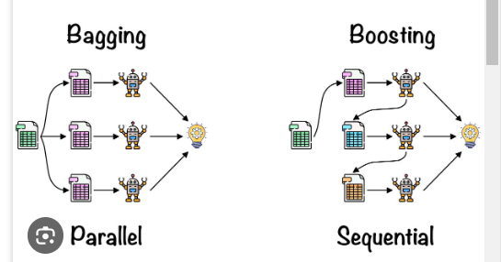

Slide 4
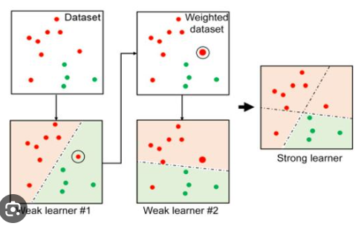
Ada boost

Slide 5
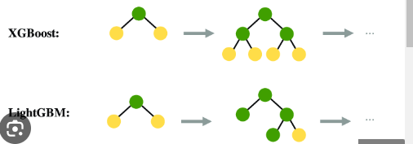
XG boost & LG boost

